Slide 1

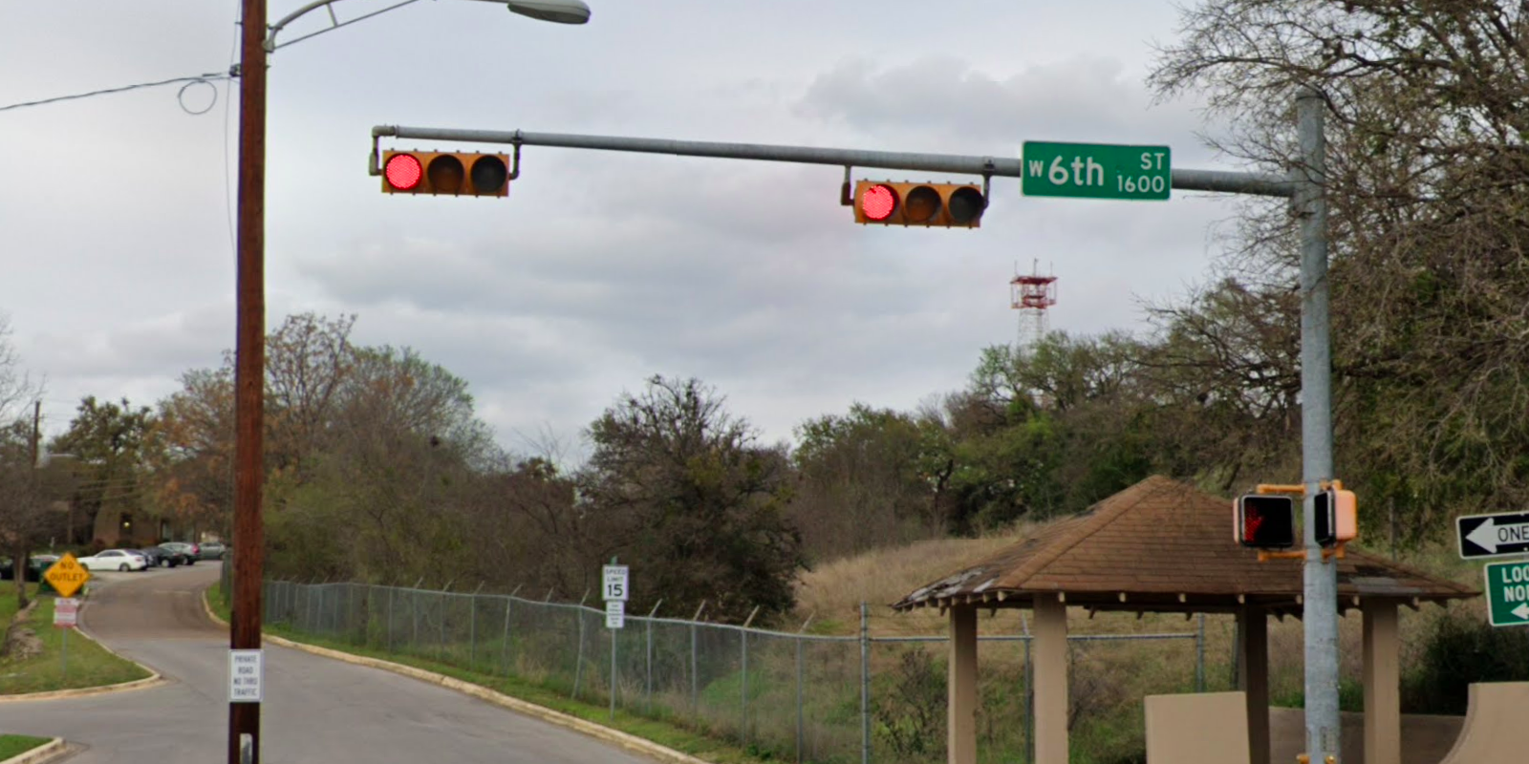
Austin Transportation Department Signs Work Orders
Created By: Susanne Gov Created Date: 2020-08-10 Location Name: 6TH ST / CAMPBELL ST Intersection ID: 5153995 Cardinal Direction: N Work Order ID: SG-20205
Sign Type | Install/Remove
Street Name Sign | Install

Slide 2
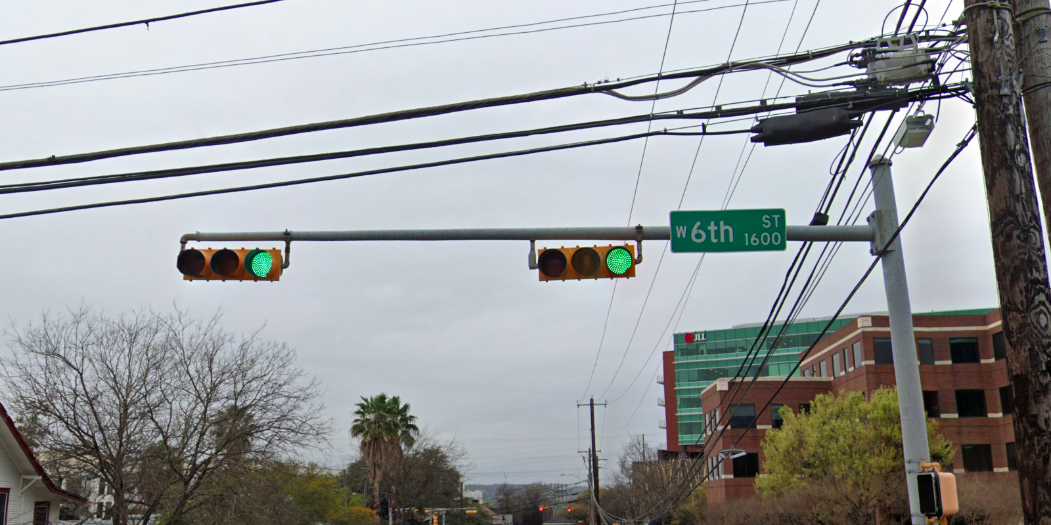
Austin Transportation Department Signs Work Orders
Created By: Susanne Gov Created Date: 2020-08-10 Location Name: 6TH ST / CAMPBELL ST Intersection ID: 5153995 Cardinal Direction: S Work Order ID: SG-20205
Sign Type | Install/Remove
Street Name Sign | Install

Slide 3
Austin Transportation Department Signs Work Orders
Created By: Susanne Gov Created Date: 2020-08-10 Location Name: 6TH ST / CAMPBELL ST Intersection ID: 5153995 Cardinal Direction: E Work Order ID: SG-20205
Sign Type | Install/Remove

Slide 4
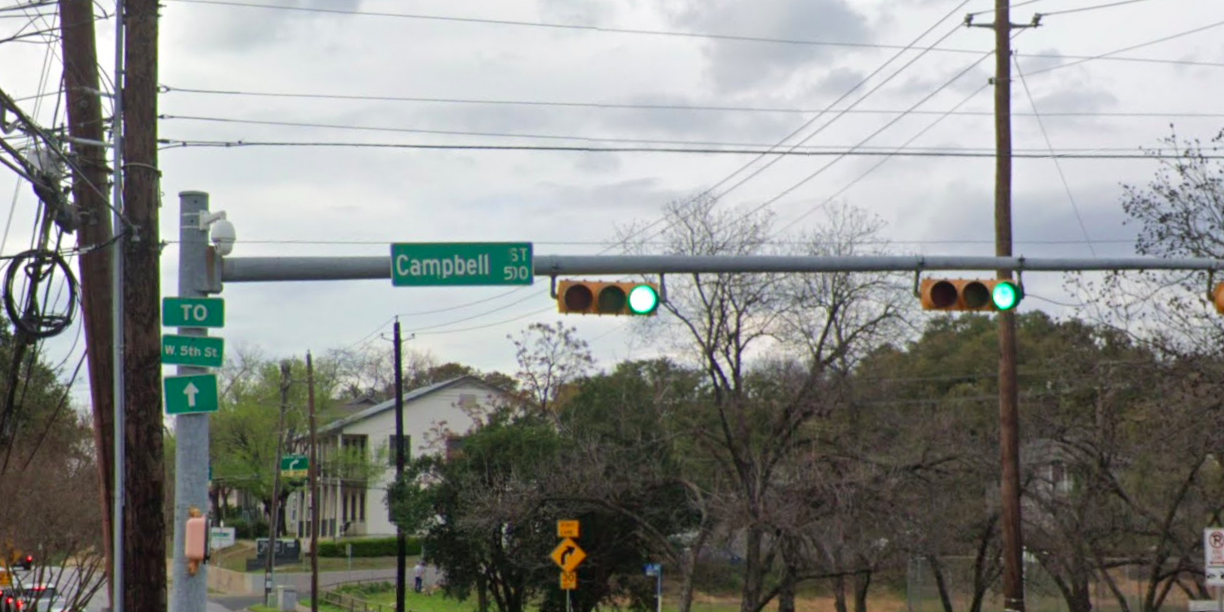
Austin Transportation Department Signs Work Orders
Created By: Susanne Gov Created Date: 2020-08-10 Location Name: 6TH ST / CAMPBELL ST Intersection ID: 5153995 Cardinal Direction: W Work Order ID: SG-20205
Sign Type | Install/Remove
Street Name Sign | Install

